Slide 1
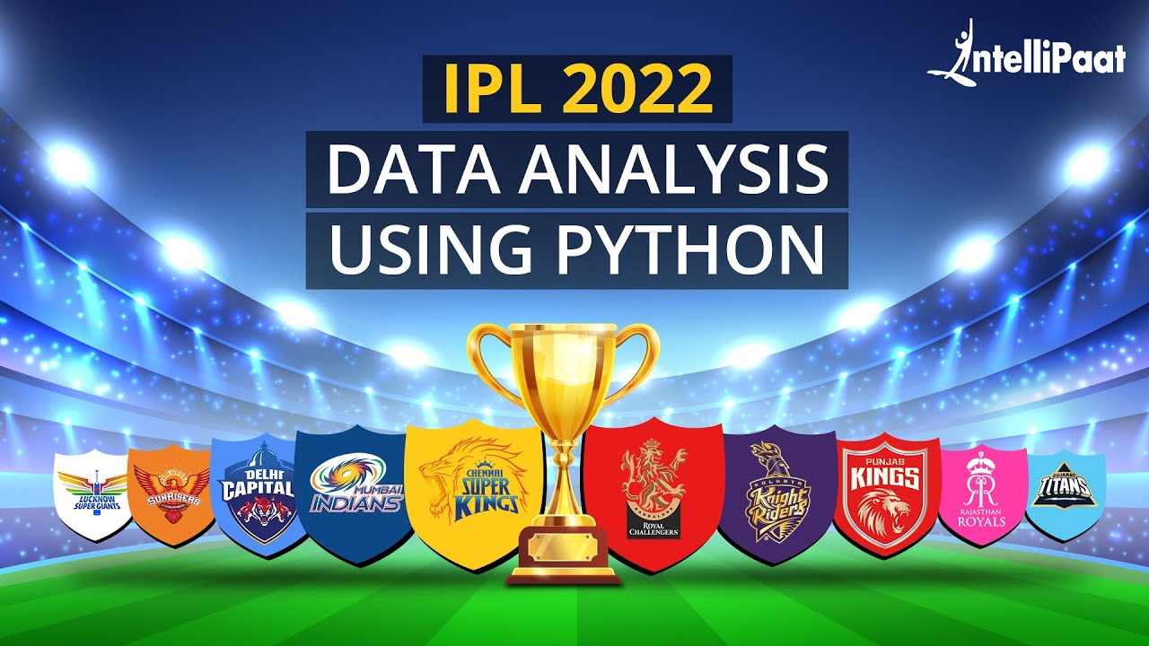

Slide 2
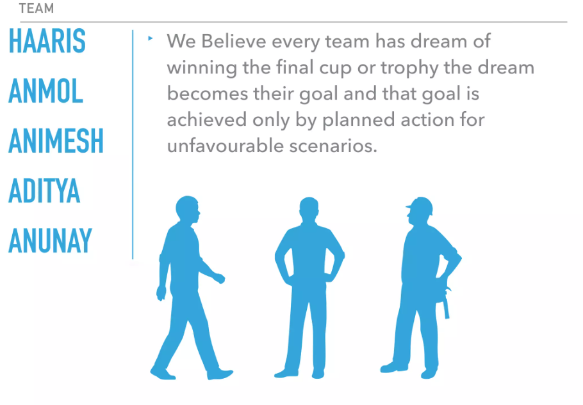
TEAM
Mahesh

Slide 3
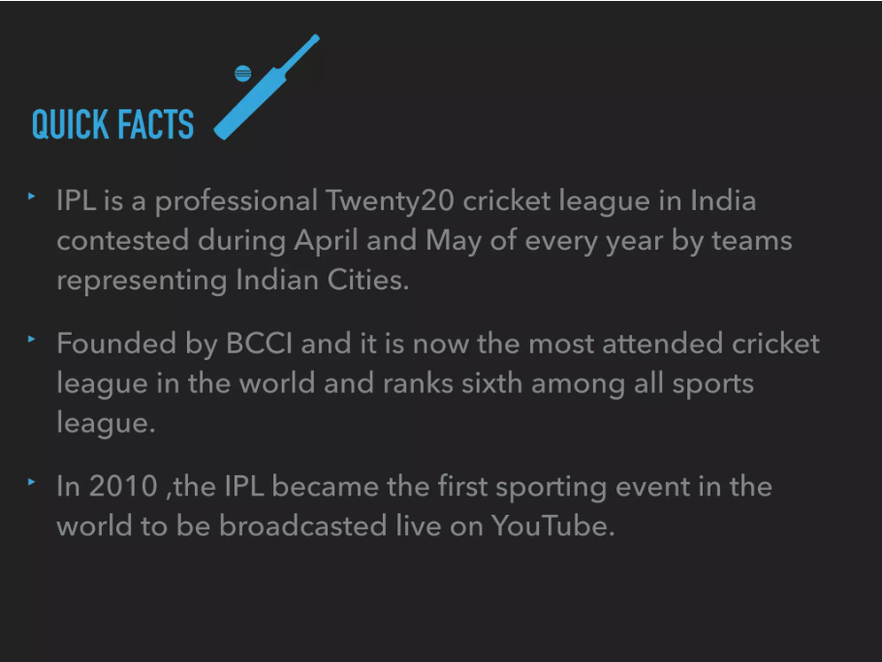

Slide 4

Data consists of
→Auction data of year 2022
→Player Type
(Batter , Bowler , Allrounder)
→Status of player(sold or unsold)
→Cost/Price of the Player

Slide 5
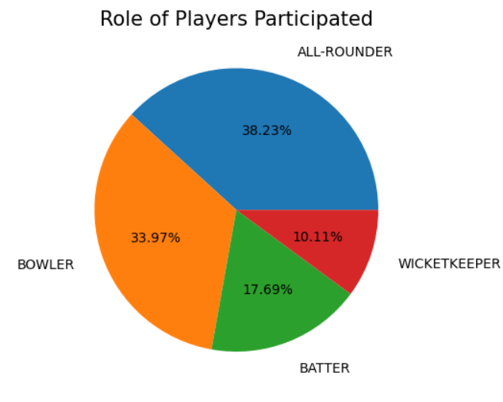

Role of Players Participated
The pie chart helps visualize the composition of player roles in the dataset.
Each segment of the pie represents the proportion of players in each role.
The chart represents the distribution of players based on their roles (forward, midfielder, defender).

Slide 6

Sold vs Unsold
* The DataFrame should contain information about players participating in the auctions, including their status (sold or unsold).
* This visualization helps understand the distribution of players based on their status (sold or unsold) in the IPL 2022 auctions.

Slide 7
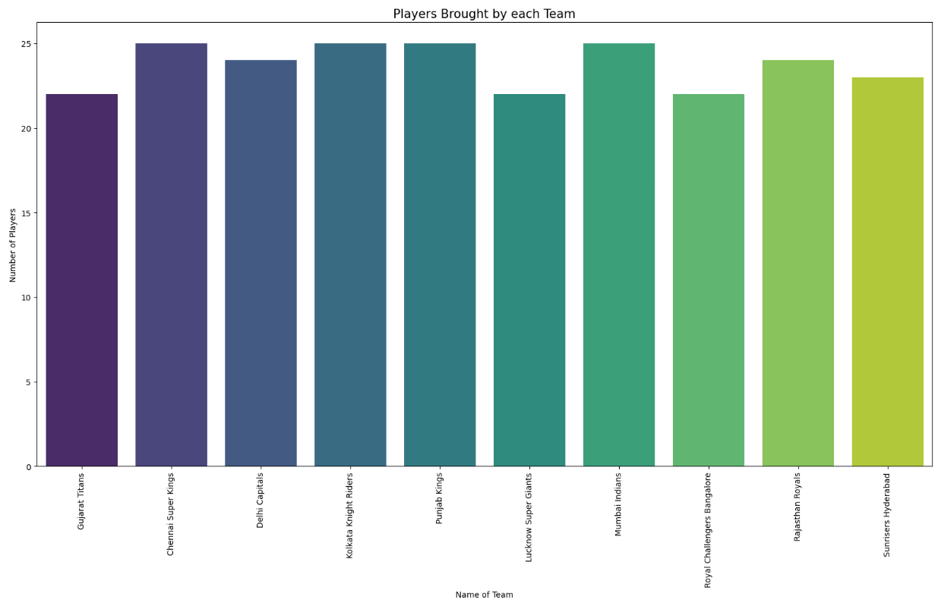
Players Bought by Each Team
This visualization helps understand the distribution of players across teams and which teams were more active in buying players during the IPL 2022 auctions.

Slide 8
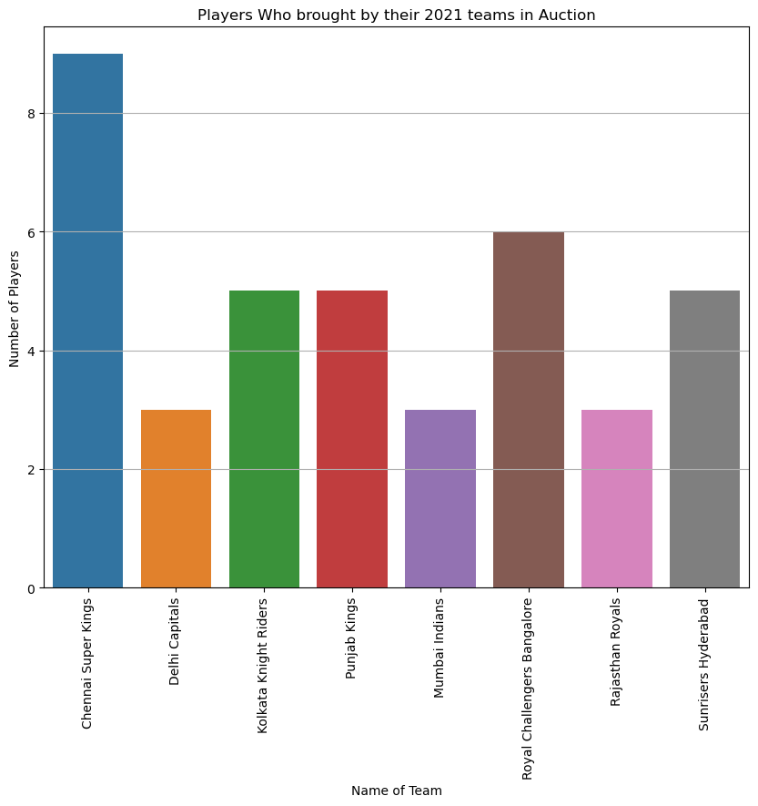
Players Brought by Their 2021 Teams in Auction
In [45]:
This visualization helps understand how many players from each team were retained or reacquired by their respective teams in the IPL 2022 auctions.

Slide 9
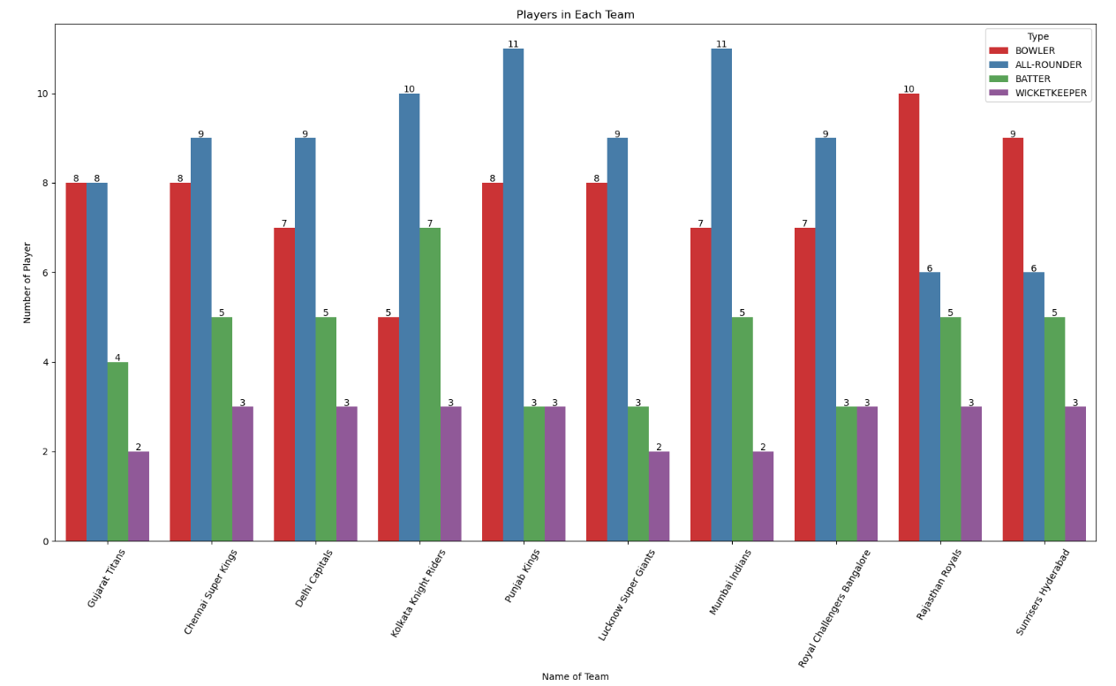
Number of Players in Each Team Based on Their Roles
* Each bar is annotated with the actual count value to provide precise information about the number of players in each role within each team.
* This visualization helps compare the player distribution in different roles across teams and identify which teams have a higher representation of specific player roles.

Slide 10
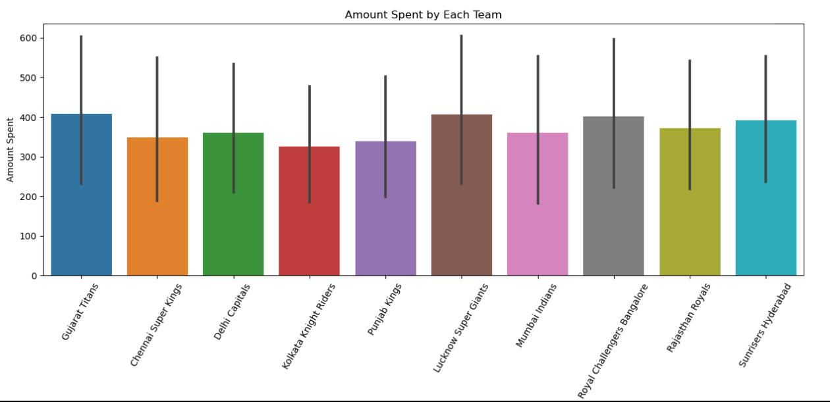
Amount Spent by Each Team in IPL 2022 Auctions
This visualization helps compare the spending patterns of different teams during the IPL 2022 auctions and understand which teams invested more or less in acquiring players.

Slide 11
Unsold Players in IPL 2022 Auctions
The plot is designed to compare the base prices of unsold players, showcasing potential star players who didn't find any buyers during the auction.

